Slide 1
Enrichment – Internet of Trees
Week Nine– Remind, Rebuild, React

Slide 2
Today
Recap –US
Back to boxes – US
React ☺

Slide 3
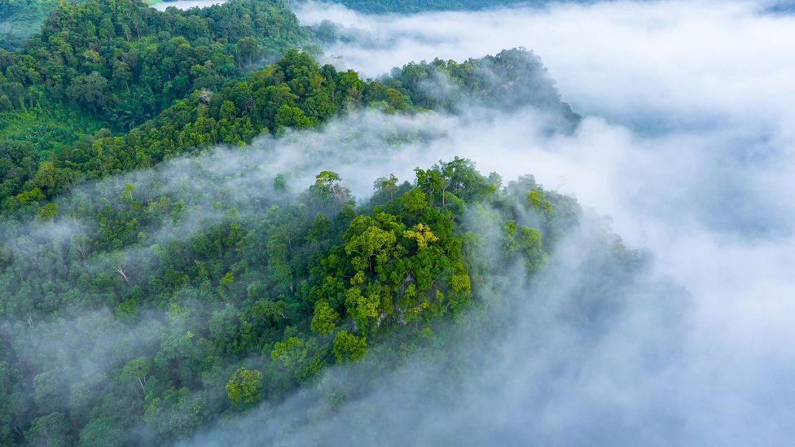
Hello Trees

Slide 4
Trees SLOW – but do not PREVENT – climate change
Protecting existing forests and planting new ones are surely good things to do. However, scientists say we must not place too much faith in trees to save us. A trillion extra trees = one quarter of the CO2 removed?
Trees will definitely help us slow climate change, but they won’t reverse it on their own.

Slide 5
A Balancing Act
Planting more trees typically makes the land darker. Since dark surfaces absorb more heat, a dark tree-covered surface will trap more of the Sun’s heat – and warm the local climate.
The best place to plant trees is in the tropics - where trees grow fastest and thus trap the most CO2. In contrast, planting in the UK, much of Europe and parts of the US – ‘may’ have no net effect on climate.

Slide 6
Haze from Trees
Trees emit chemicals into the air. “That’s the piney smell you get when you walk through a forest,” These chemicals stick together to form tiny floating particles that create a faint haze.
This haze scatters sunlight back into space, cooling the planet. This haze also creates thicker low cloud, which also bounces sunlight back to space.

Slide 7
Reminder - The Challenge
To gather data from trees on air quality around Clitheroe and the Local area to see what effect trees might have on air quality and to see how air quality varies
To find ways to make the data exciting for children in KS1 and KS2 and also to package that data in interesting ways for the local community

Slide 8
What can we do?
https://www.woodlandtrust.org.uk/support-us/act/your-school/green-tree-schools-award/?utm_source=/award&utm_medium=furl
https://www.earthday.org/earth-day-2021/
https://www.naturalclimate.solutions/

Slide 9
Follow on work - optional
Continue with the work for the schools – think about where you can fit data into what you are doing
Look and learn what can be done with excel wrt. the data we seem to be able to catch

