Slide 1
Enrichment – Internet of Trees
WeekSix– Foresting Data

Slide 2
Today
Recap from last week –US
Let’s look at data - US
Data Exploration– YOU

Slide 3
Reminder - The Challenge
To gather data from trees on air quality around Clitheroe and the Local area to see what effect trees might have on air quality and to see how air quality varies
To find ways to make the data exciting for children in KS1 and KS2 and also to package that data in interesting ways for the local community

Slide 4
Add ins?
Anyone got anything to show / talk about?
Please put in chat now☺

Slide 5
Data
 | Temperature | Pressure | Humidity | ……..
00.01 | 32.02 | 12.2 | 25
00.02 | 32.03 | 12.3 | 25
00.03 | 32.02 | 12.3 | 25
00.04 | 32.02 | 12.5 | 26
00.05 | 32.02 | 12.5 | 26
00.06 | 32.02 | 12.4 | 25

Slide 6
What can we do with data?
Describing data
Measures of spread and central tendency
Charts and Diagrams
Looking for Connections between data
Correlation
Prediction
Alignment

Slide 7
Using Excel
Describing data
Sum
Average
Range
Charts and Diagrams
Thinking about Frequency Tables

Slide 8
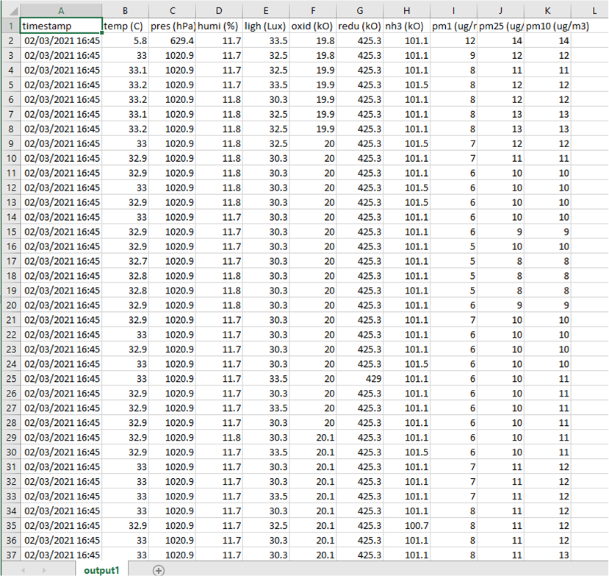
Dan’s been dragging up data☺

Slide 9
Task for today
In a group look at the excel sheet and see what you can discover
Think about how you might describe this data to children
Come back with what you have ..

Slide 10
ReGroup
Let’s gather in what you have……..

Slide 11
Follow on work - optional
Continue with the work for the schools – think about where you can fit data into what you are doing
Look and learn what can be done with excel wrt. the data we seem to be able to catch

