Slide 1
Enrichment – Internet of Trees
Week Eight– Back to the Box…

Slide 2
Today
Recap from last week –US
Designing a housing - US
Prototyping a housing – YOU

Slide 3
Reminder - The Challenge
To gather data from trees on air quality around Clitheroe and the Local area to see what effect trees might have on air quality and to see how air quality varies
To find ways to make the data exciting for children in KS1 and KS2 and also to package that data in interesting ways for the local community

Slide 4
Add ins?
Anyone got anything to show / talk about?
Please put in chat now☺

Slide 5
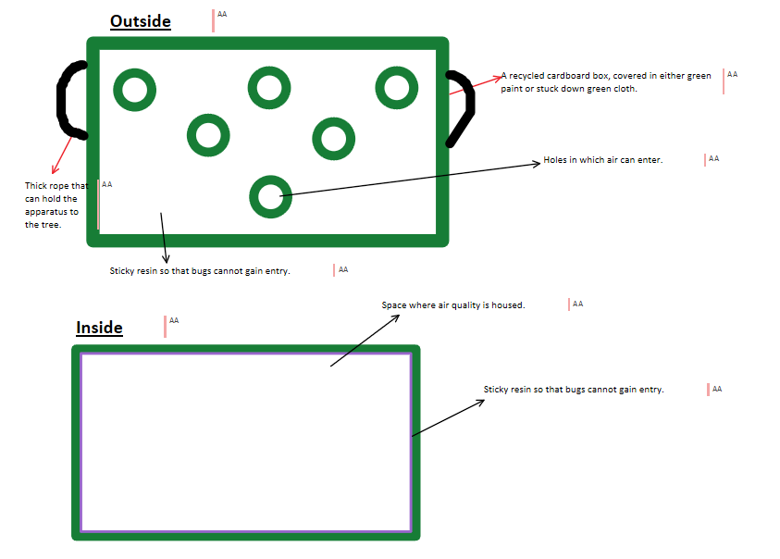
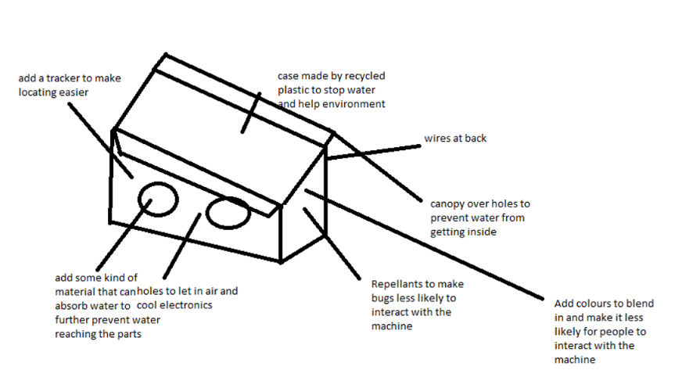
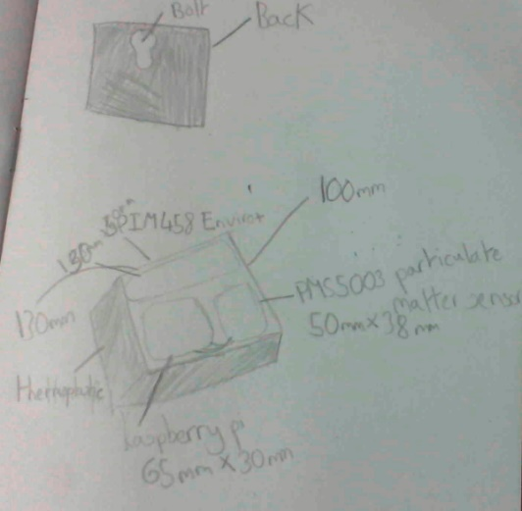
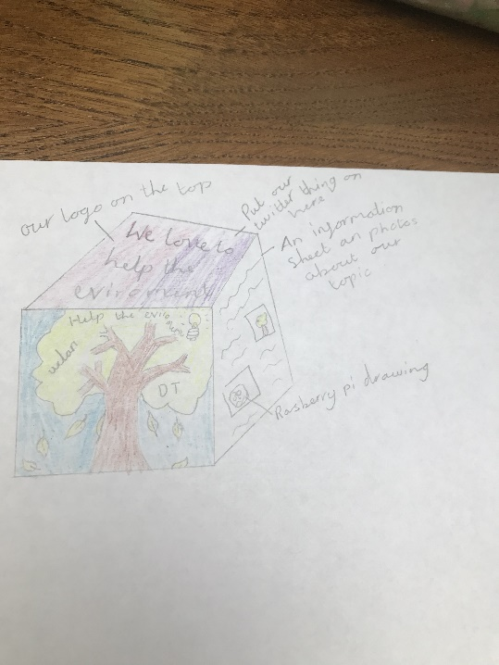
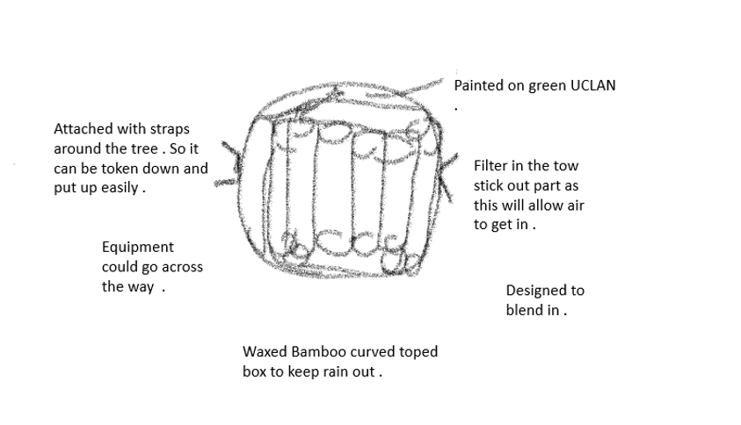
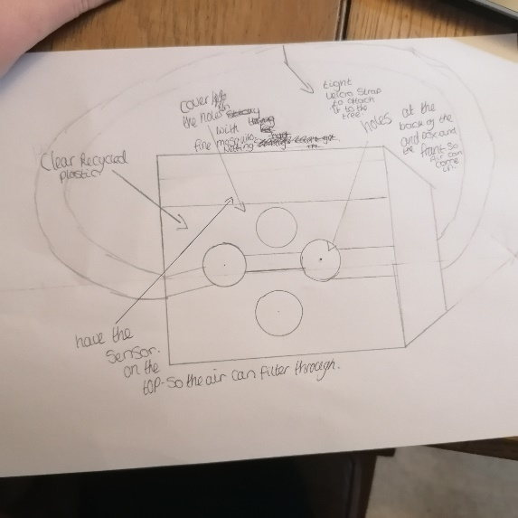
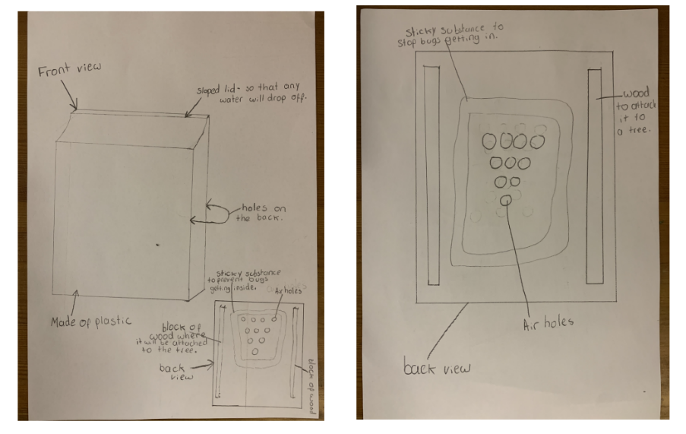
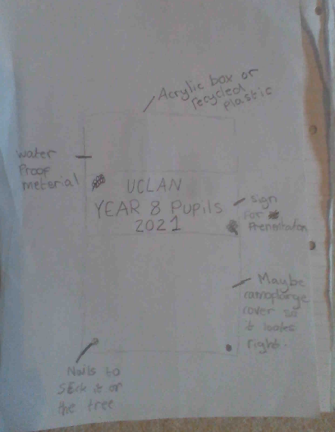
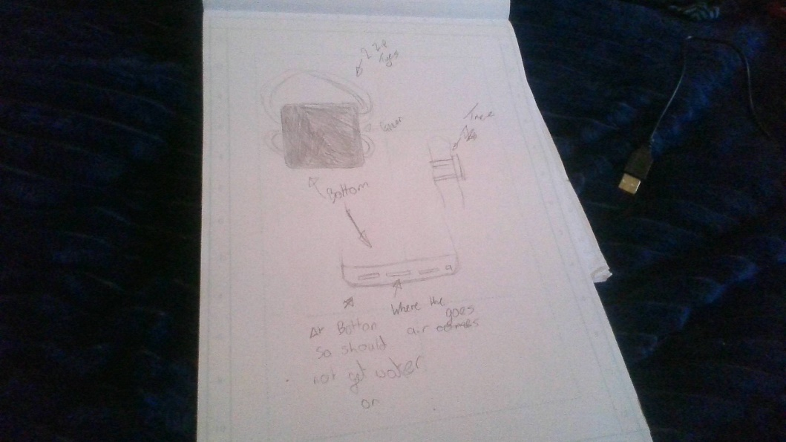
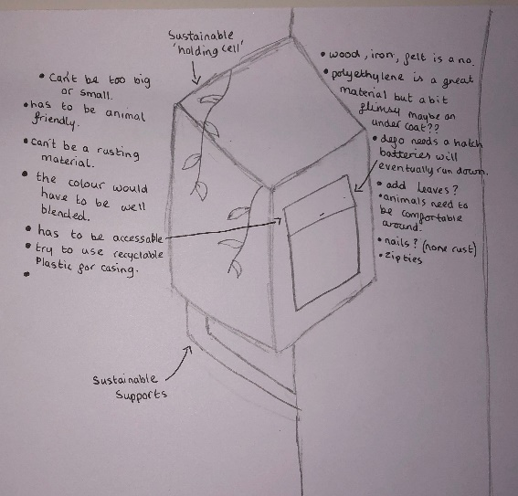
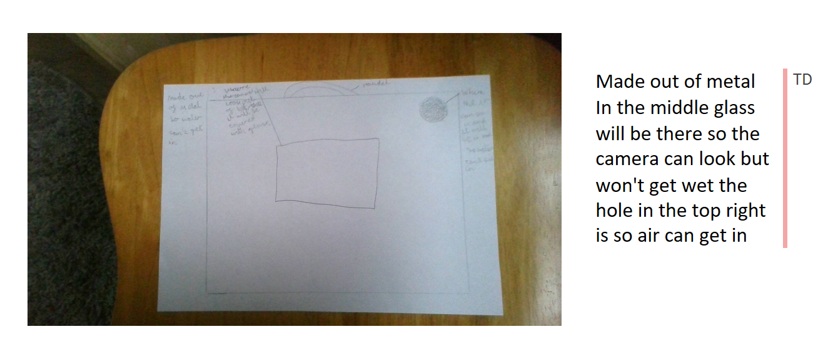

Slide 6
Designs So Far
Great Ideas!
Now you need to make the housings x 4
Important things to think about
Needs to be big enough to fit in the tech
Needs to be rain/wind/bird/squirrel proof
Needs to let in the air
Needs to attach to a tree (without damaging it)
Needs to be possible for you to make

Slide 7
Needs to be big enough to fit in the tech
Will need to unpack the tech and measure it
Raspberry Pi (will have GPIO board and Radio Bonnet and header cable on it)
Battery Pack
Particulate matter sensor
Only touch the edges of circuit boards!
Also think about where wires will go
USB from battery to Pi
Short cable from Pi to Particulate matter sensor

Slide 8
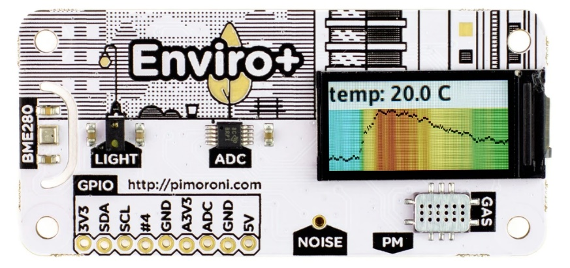
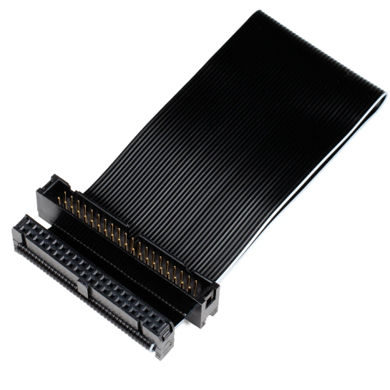
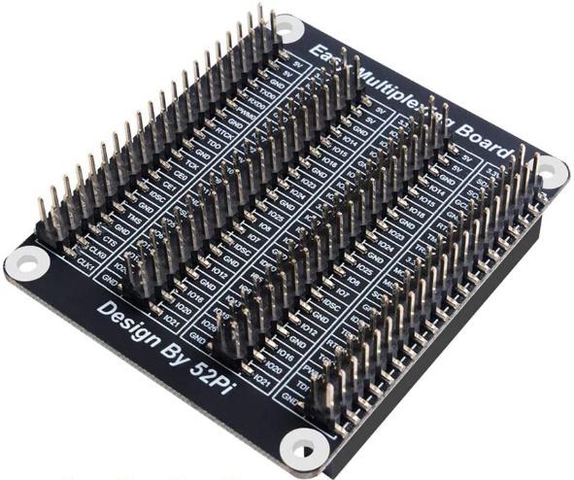
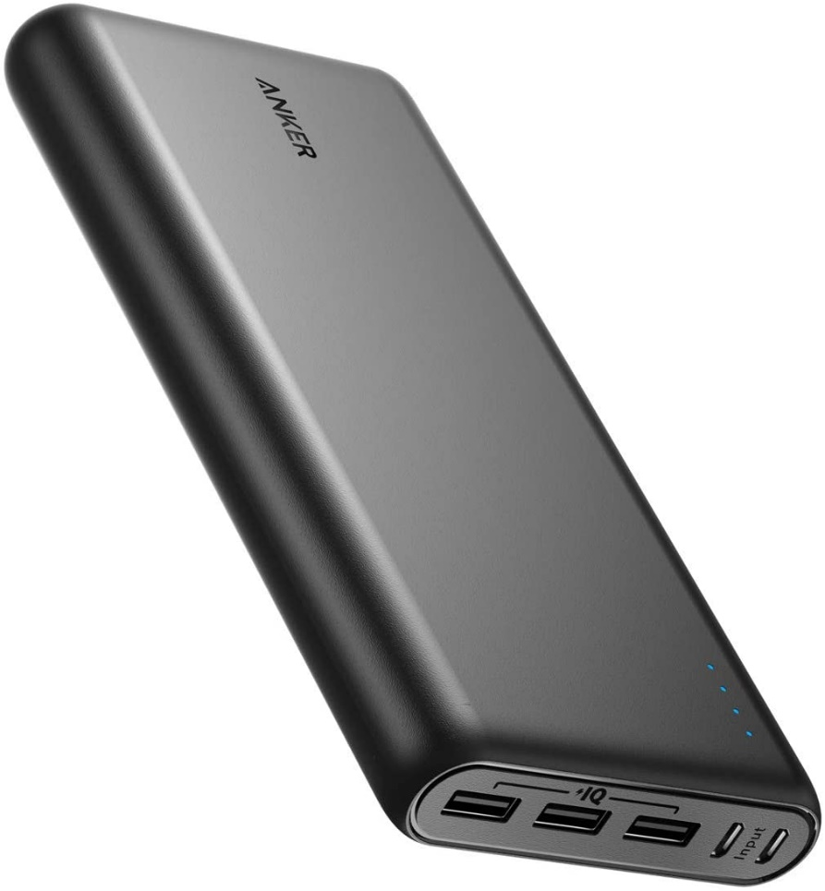
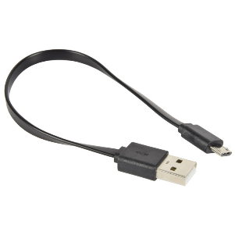
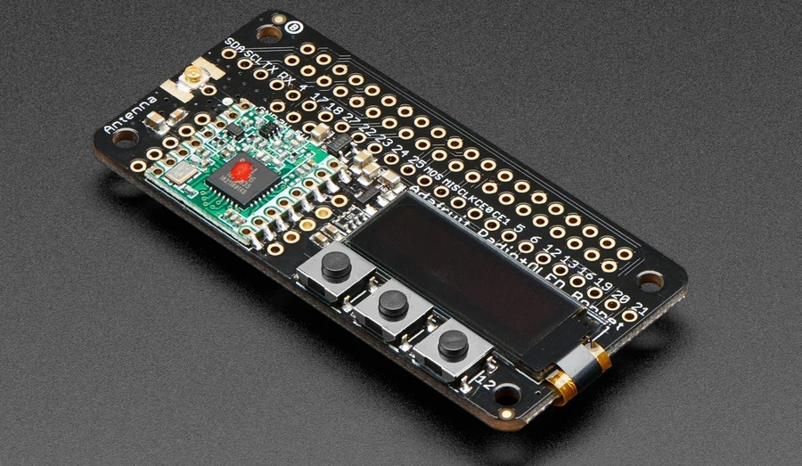
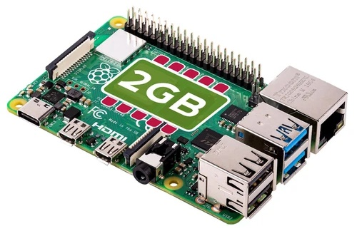
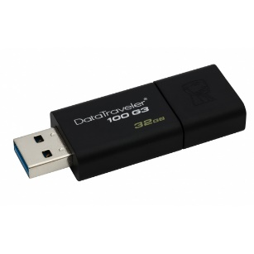

Slide 9
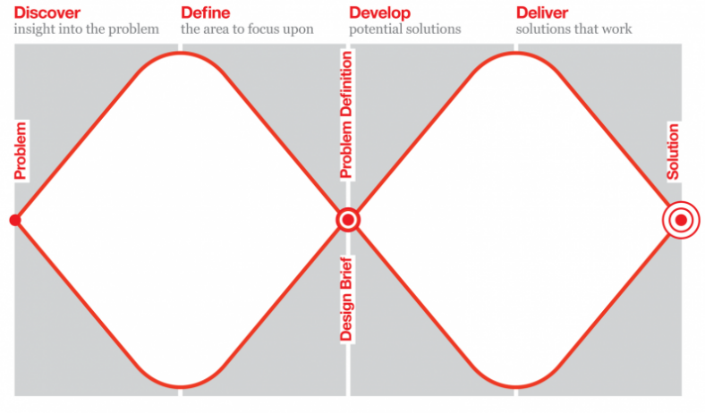
Needs to be possible for you to make
Will be laser cutting the housings!
How to mount the tech inside?
How to make sure it can be attached to a tree?
Need to finalize design on paper today if possible
Can have multiple designs to choose from

Slide 10
Tasks for Today
In Groups
Un-pack and measure the tech
Pick an existing idea (or ideas) to work on or create a new one
Scale the design to fit in the tech (ie make sure the stuff fits in!)
Paper-prototype using nets

Slide 11
Nets

Slide 12
Follow on work - optional
Continue with the work for the schools – think about where you can fit data into what you are doing
Look and learn what can be done with excel wrt. the data we seem to be able to catch

