Slide 1
Enrichment – Internet of Trees
Week Four – Talking about Trees

Slide 2
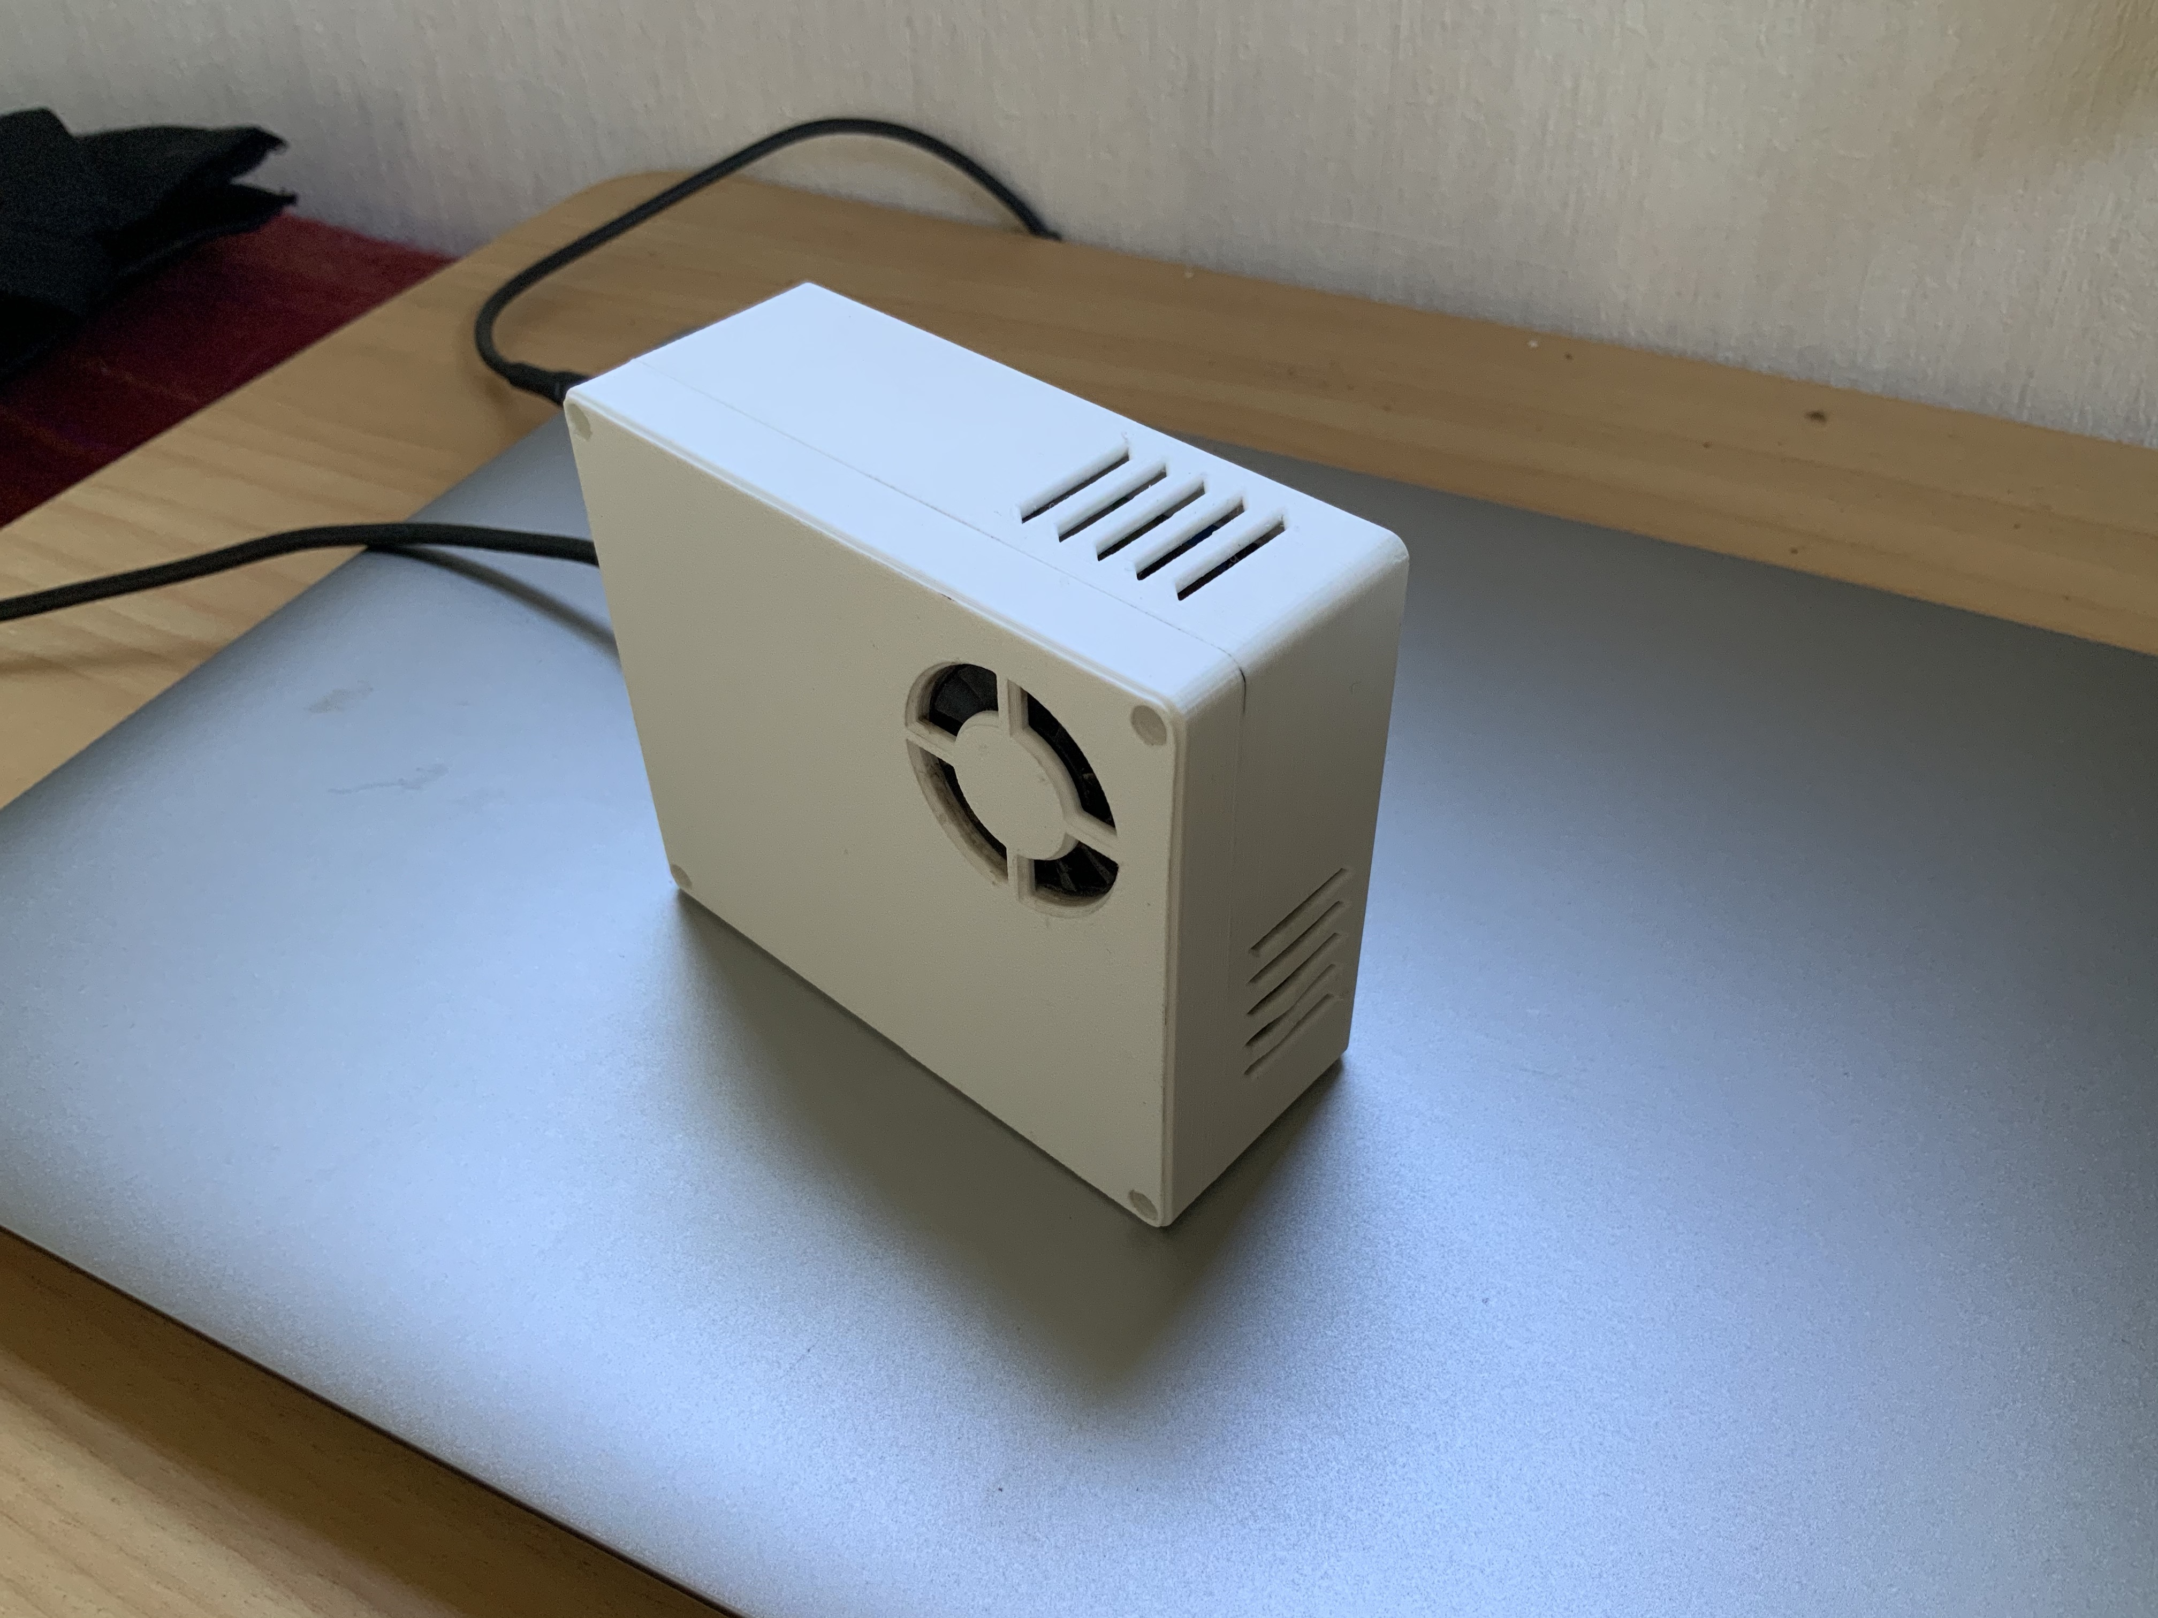

Slide 3
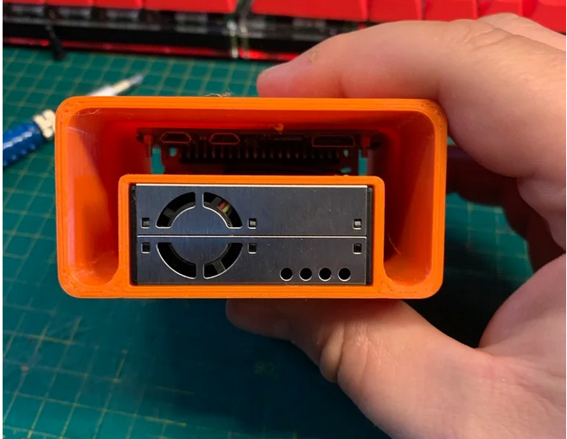
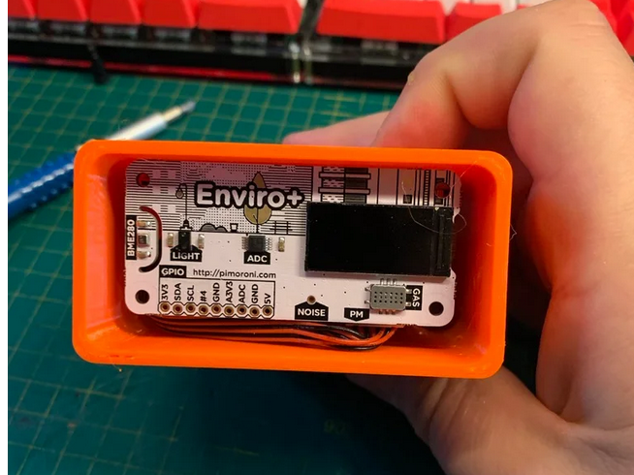

Slide 4
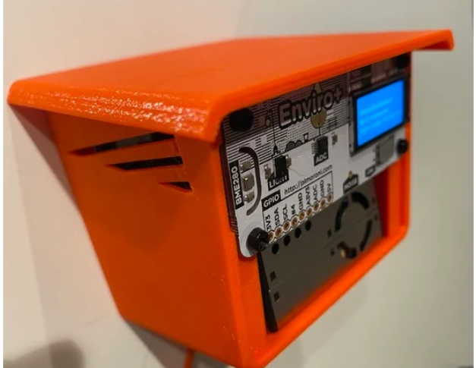

Slide 5
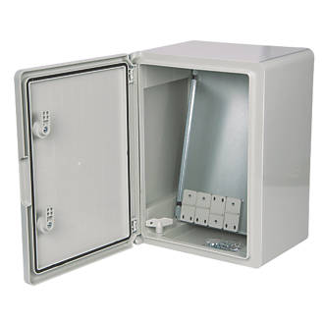
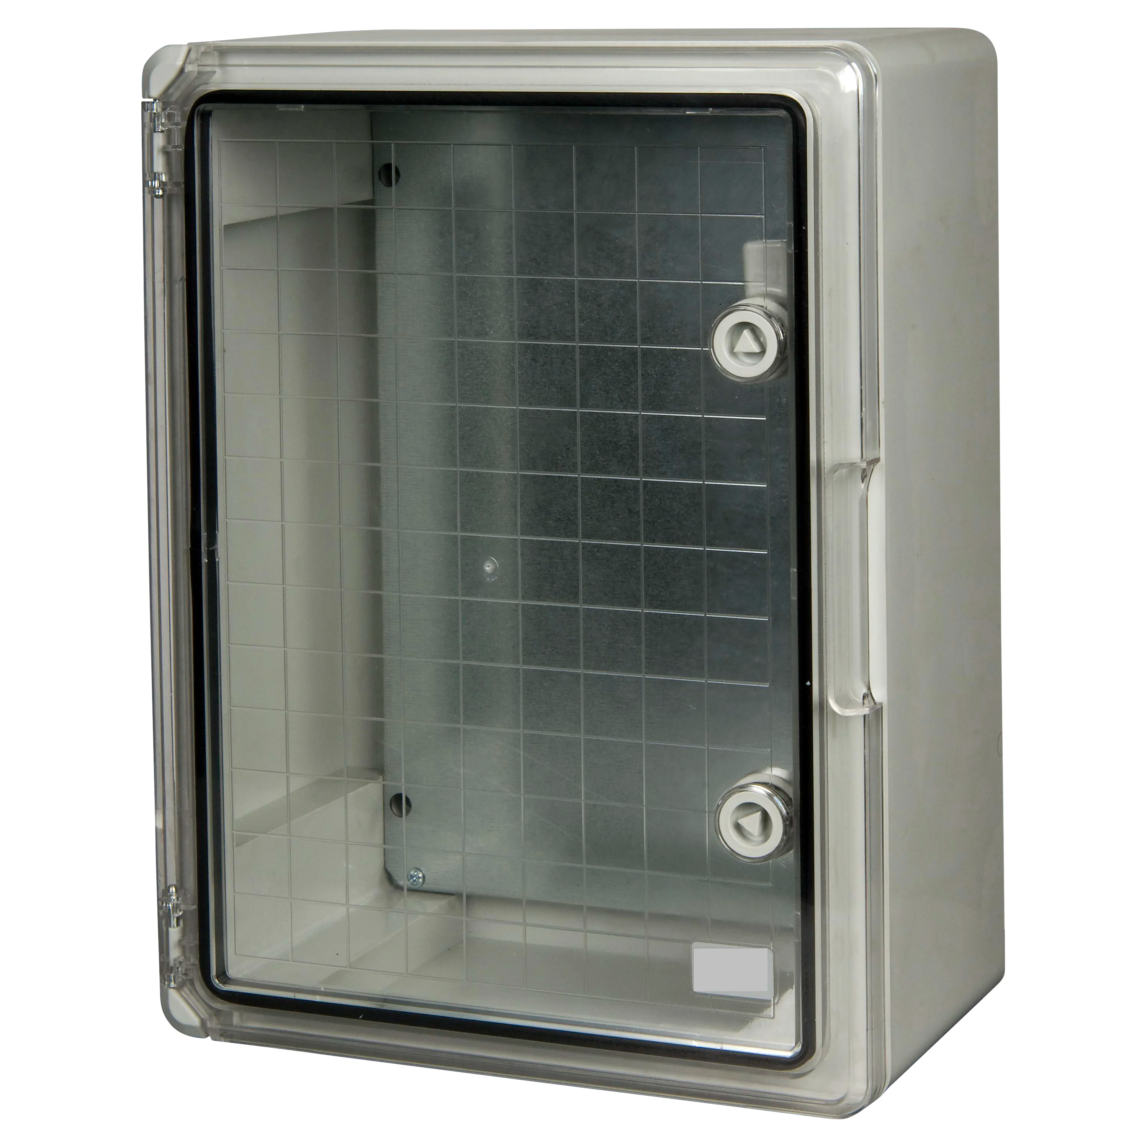
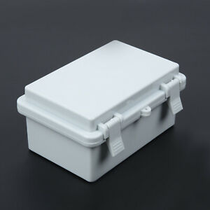

Slide 6
Today
Recap from last week -US
Talking about Trees– YOU
Design decisions - ALL

Slide 7
Reminder - The Challenge
To gather data from trees on air quality around Clitheroe and the Local area to see what effect trees might have on air quality and to see how air quality varies
To find ways to make the data exciting for children in KS1 and KS2 and also to package that data in interesting ways for the local community

Slide 8
Add ins?
Anyone got anything to show / talk about?
Please put in chat now☺

Slide 9
Science Ambassadors
A Science Ambassador
Explains Science using scientific vocabulary
Shares the science being done in a suitable format
Gets feedback from children and captures their voice and enthusiasm
Engages children where possible

Slide 10
How it will look
Four Stages
Introduction to the project and advertising it
Opening up interaction with the project activities
Providing possibilities to work with the DATA gathered
Evaluation of the project and planning for further interaction

Slide 11
Medium and Message
We have to think about WHAT we want to say and about HOW we want to say it .
WHAT – we are placing sensors on trees to gather data about pollution, temperature …… and we will hope to establish the effects of location, weather and other external factors on air quality and air temperature.

Slide 12
Medium and Message
HOW
Website or Blog
Video or Slide deck
Posters or Pamphlets

Slide 13
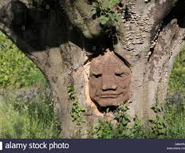
Weather and Air Quality
wind speed and direction.
temperature.
humidity.
rainfall.
solar radiation.

Slide 14
Climate change and Air Pollution
Air pollutants have a complex relationship with climate change. Some pollutants, such as black carbon and ozone, increase warming by trapping heat in the atmosphere,
Others, such as sulfur dioxide forming light reflecting particles, have a cooling effect on the climate

Slide 15
Task for today
In a group decide how you will introduce the project to children
Choose a message and a medium
Choose a school to focus on
Start to design that first information.

Slide 16
ReGroup
Let’s gather in what you have……..

Slide 17
Follow on work - optional
Find out anything you can about trees in your neighbourhood or region. Measure some trees. Find out what others measure ABOUT trees.
Select a tree to keep an eye on over the next 20 weeks – make a log of how its size and look changes – photograph it once a week at the same time. Take the SAME photo of it at 8am, 12 noon, 4pm and 8pm to see how the light it gets changes

