Slide 1
Enrichment – Internet of Trees
Week Three – Tree Telemetry

Slide 2
Today
What we can sense/measure - US
Designing our sensor boxes – YOU

Slide 3
Add ins?
Anyone thing of a good twitter handle?
Anyone got anything to show / talk about?

Slide 4
Reminder - The Challenge
To gather data from trees on air quality around Clitheroe and the Local area to see what effect trees might have on air quality and to see how air quality varies
To find ways to make the data exciting for children in KS1 and KS2 and also to package that data in interesting ways for the local community

Slide 5
Reminder - Data and Science
To gather data from trees on air quality around Clitheroe and the Local area to see what effect trees might have on air quality and to see how air quality varies
Data = ‘facts and statistics collected together for reference or analysis’
Science = ‘the systematic study of the structure and behaviour of the physical and natural world through observation and experiment’

Slide 6
Sensing Stuff
PMS5003 Particulate Matter Sensor
https://shop.pimoroni.com/products/pms5003-particulate-matter-sensor-with-cable
PIM458 Enviro+
https://shop.pimoroni.com/products/enviro
Raspberry Pi
https://www.raspberrypi.org/products/raspberry-pi-4-model-b/
Battery Pack

Slide 7
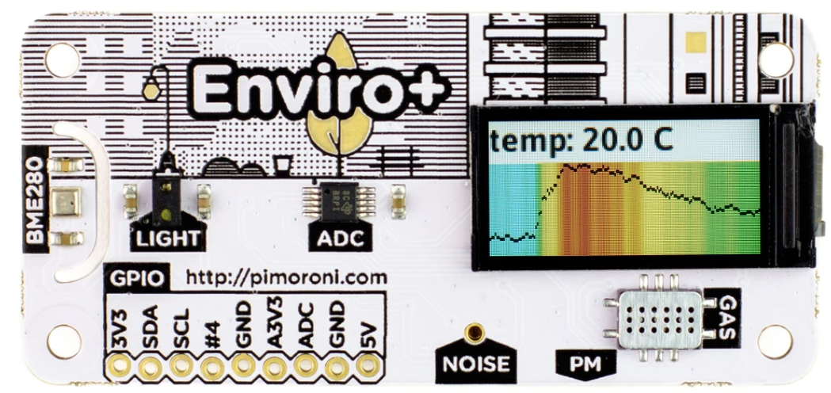
Data: PIM458 Enviro+
Temperature, Pressure, Humidity
Light and Proximity
Nitrogen dioxide (NO2)
Produced when fossil fuels are burned (cars engines, central heating etc)
Affects human airways and lungs, can also affect vegetation.
Carbon monoxide (CO)
Produced by incomplete combustion (car engines, industry etc)
Deadly in high quantities
Ammonia (NH3)
Mainly released through agriculture
Can damage eco systems on land and in water
https://uk-air.defra.gov.uk/assets/documents/What_are_the_causes_of_Air_Pollution.pdf

Slide 8
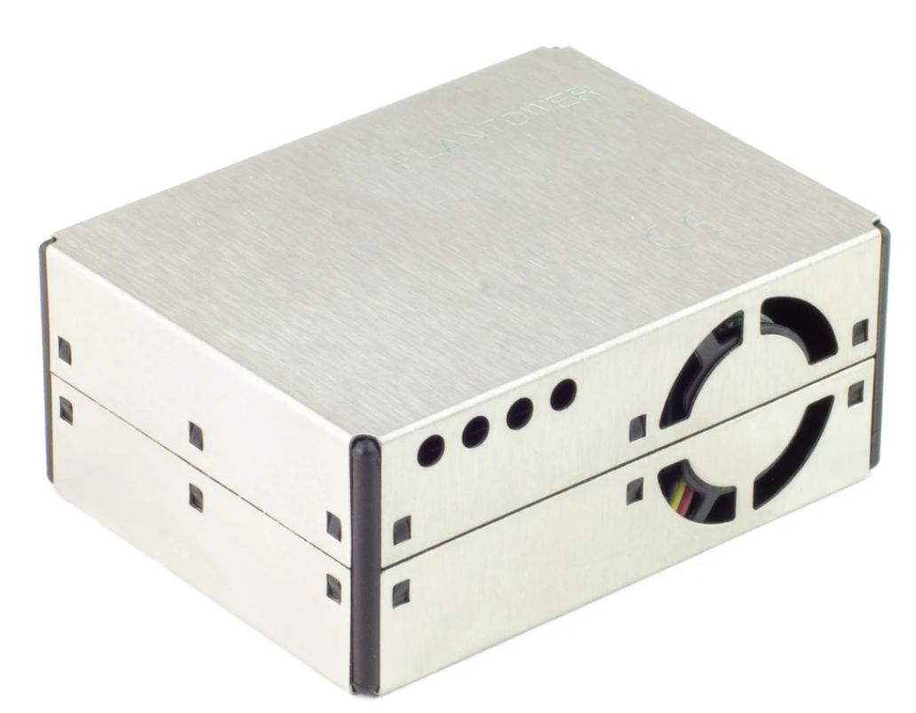
Data: PMS5003 Particulate Matter Sensor
PM1, PM2.5, and PM10
?????
PM1 = 1 micrometre or smaller, PM2.5 = 2.5 micrometre, PM10 = 10 micrometre
Human hair is 50-70 micrometres across, a fine grain of sand is 90 micrometres
Tiny solid particles in the air we can breathe in
Mostly generated by fuel combustion and transport
Also quarrying, construction and other industry
https://uk-air.defra.gov.uk/assets/documents/What_are_the_causes_of_Air_Pollution.pdf

Slide 9
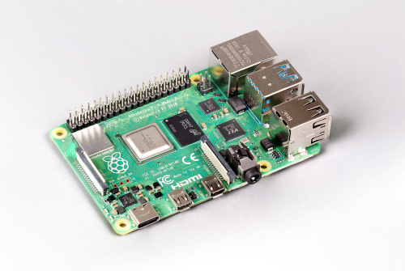
Raspberry Pi
Miniature computer
Can run on batteries
Can store Data
Can talk to sensors
Not weather proof…
Not so good at clinging on to a tree…

Slide 10
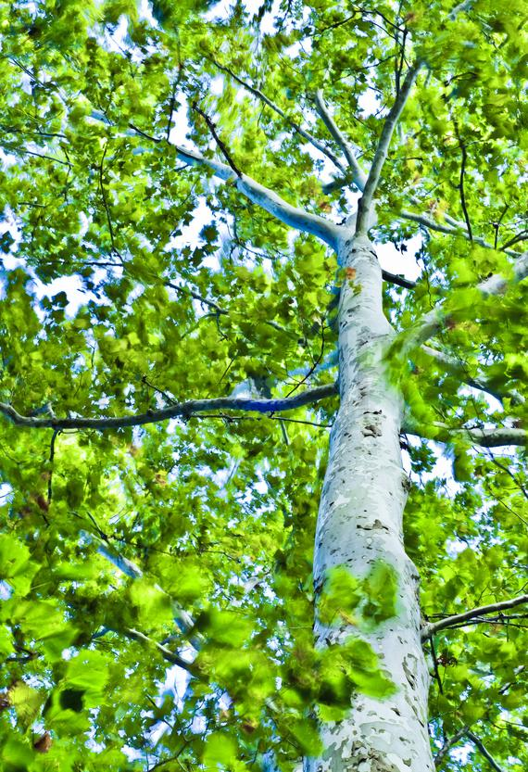
Design Challenge…
Design a box for our sensing equipment
What is it made out of?
What colour is it?
What shape is it?
How is it fixed to a tree?
How is it weather proof?
How can air still get in?
What else might be important?

Slide 11
Follow on work - optional
Find out anything you can about trees in your neighbourhood or region. Measure some trees. Find out what others measure ABOUT trees.
Select a tree to keep an eye on over the next 20 weeks – make a log of how its size and look changes – photograph it once a week at the same time. Take the SAME photo of it at 8am, 12 noon, 4pm and 8pm to see how the light it gets changes

