Slide 1
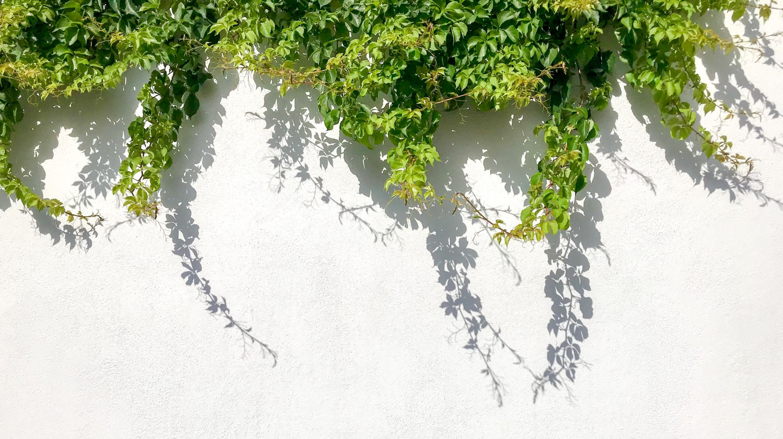
Enrichment – Internet of Trees
Week Two – What Trees Do

Slide 2
Today
Science and Trees- US
Looking for Trees– YOU
Sensing 1.0 - US

Slide 3
Reminder - The Challenge
To gather data from trees on air quality around Clitheroe and the Local area to see what effect trees might have on air quality and to see how air quality varies
To find ways to make the data exciting for children in KS1 and KS2 and also to package that data in interesting ways for the local community

Slide 4
Add ins?
Anyone thing of a good twitter handle?
Anyone got anything to show / talk about?

Slide 5
Data and Science
To gather data from trees on air quality around Clitheroe and the Local area to see what effect trees might have on air quality and to see how air quality varies
Data = ‘facts and statistics collected together for reference or analysis’
Science = ‘the systematic study of the structure and behaviour of the physical and natural world through observation and experiment’

Slide 6
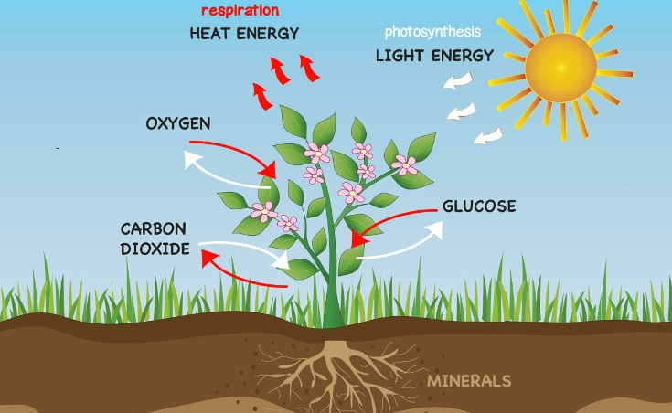
What Trees Do
Respire - Plants combine glucose and oxygen to create CO2 and water. Humidity and light affect leaf respiration. Plants respire all the time, whether it is dark or light.
Photosynthesise - Plants PHOTOSYNTHESISE only when they are in the light. They take in water and CO2 to make glucose and oxygen

Slide 7
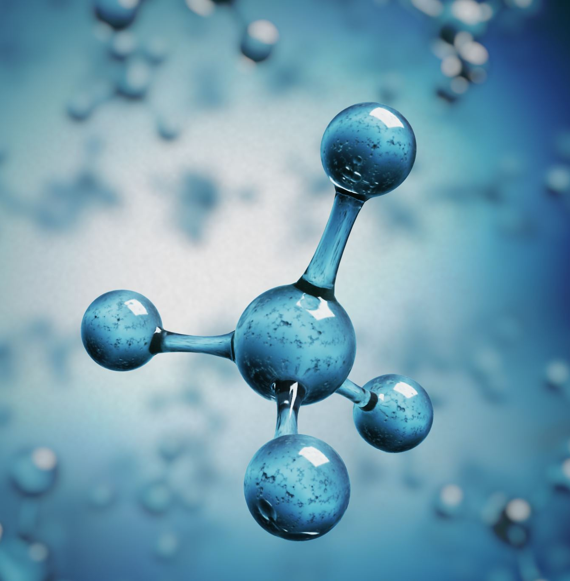
Trees making ’food molecules’ (glucose)
The mass of a tree is primarily carbon. The carbon comes from carbon dioxide used during photosynthesis. During photosynthesis, plants convert the sun’s energy into chemical energy which is captured within the bonds of carbon molecules built from atmospheric carbon dioxide and water.
Yes, the carbon from carbon dioxide in the air we breathe out ends up in “food” molecules (called glucose) each of which contains 6 carbon atoms (and 12 hydrogen atoms and 6 oxygen atoms).

Slide 8
Growing tall..
However, there is a negative side as well. Plants use the energy in some of the carbon molecules they make for the activities to keep themselves alive and to reproduce. This process is called cellular respiration, which all living things do.
But there are still carbon molecules (glucose) left over. These left-over glucose molecules are used to form the complex structures of plants, such as leaves, stems, branches and roots as well as fruits, seeds, nuts or vegetables. Each year trees use the left-over carbon molecules to add to themselves, making themselves bigger in mass (size).

Slide 9
Diameter at Breast Height
Diameter at breast height, or DBH, is the standard for measuring trees. DBH refers to the tree diameter measured at 4.5 feet above the ground.
DBH can be measured quickly with a specially calibrated diameter tape, often referred to as a d-tape, that displays the diameter measurement when wrapped around the circumference of a tree. If you don't have access to a d-tape, you can find the diameter of the tree using a string, a measuring tape, a thumb tack, and a calculator.

Slide 10
What else can we measure?
Standard measures – e.g. DBH will give VALIDITY to our science as we will be collecting the same ‘type’ of DATA as other people
This will allow us to compare our results with those of others
https://www.treemarker.co.uk/product/spencer-loggers-tape?gclid=Cj0KCQiAmL-ABhDFARIsAKywVaeB2LeeZhNVzV_d9lFkaMiZfaunQH1egsmXkJTmek1vw0L17sguRoEaAt1WEALw_wcB
WHAT DO OTHERS MEASURE???

Slide 11
Breathe in – breathe out (not quite)
Conditions | Photosynthesis v respiration | Overall result
Dark | Respiration but no photosynthesis | Oxygen taken in, carbon dioxide given out
Dim light | Photosynthesis rate equals respiration rate | Neither gas is taken in or given out
Bright light | Photosynthesis rate greater than respiration rate | Carbon dioxide taken in, oxygen given out

Slide 12
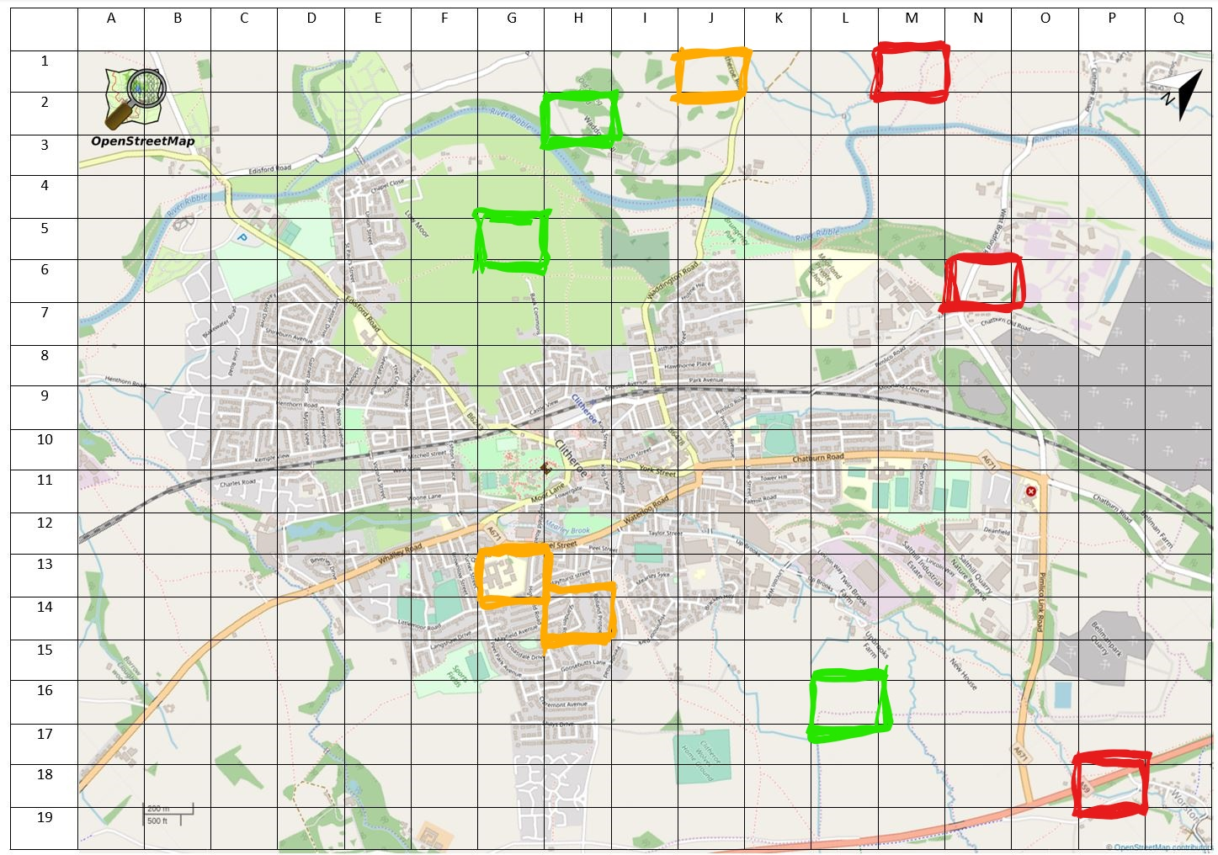
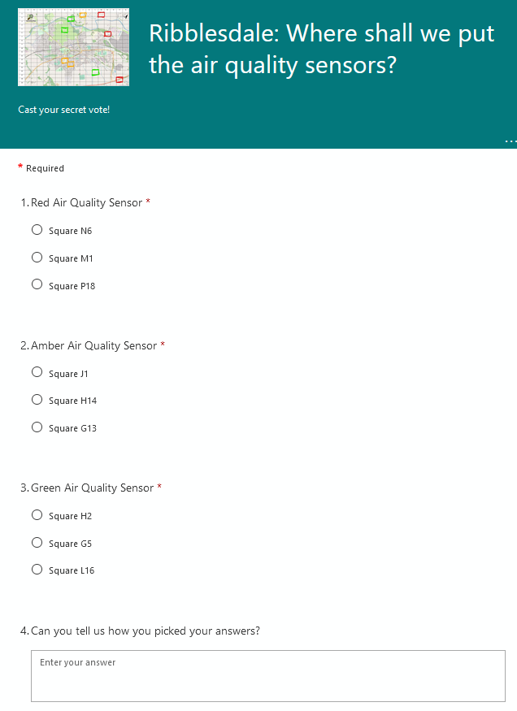
Activity: Where to put the sensors?
http://bit.ly/3sTRkhv
https://forms.office.com/Pages/ResponsePage.aspx?id=gpn262sDxEyyAnrrGUxQZT-titHpyERCpBZwLtg8a6lUQkw5QVhEWjJSMTRJREoxNFkwVFVQRVZZUy4u

Slide 13
And the winner is??

Slide 14
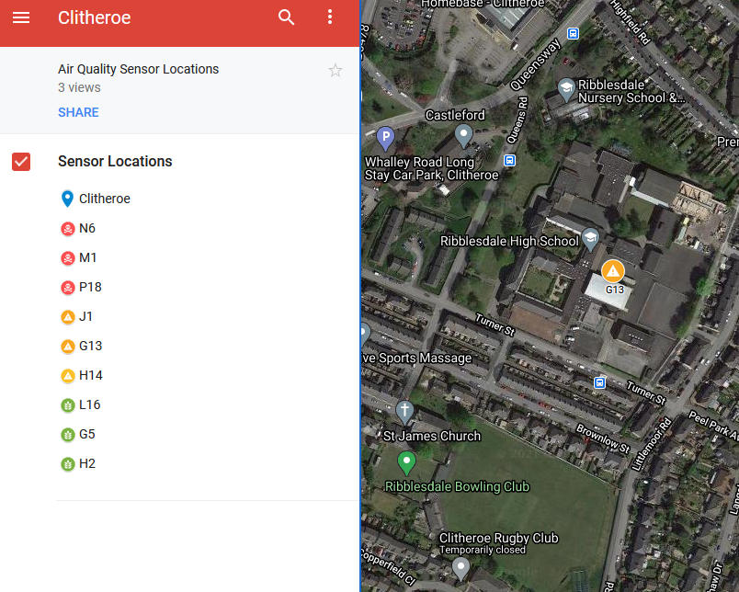
Next task: Find a tree for your sensor
In breakout rooms (Red, Amber and Green)
Head to the Google map http://bit.ly/3t8Wlmq
Find the winning location for your colour
Pick the best tree (as a group)
Tell your facilitator
Who will circle it and take a screen grab
https://www.google.com/maps/d/edit?mid=1xXib_t7bWp4dxO-9yuSxQH-OEsqdQdhv&usp=sharing

Slide 15
Follow on work - optional
Find out anything you can about trees in your neighbourhood or region. Measure some trees. Find out what others measure ABOUT trees.
Select a tree to keep an eye on over the next 20 weeks – make a log of how its size and look changes – photograph it once a week at the same time. Take the SAME photo of it at 8am, 12 noon, 4pm and 8pm to see how the light it gets changes

